Slide 1

Fundamental Banking System
Team : Tech Coders
Prof. Do Hyunsook
BANK

Slide 2

Contents
Description
Core requirements
Contributions
Technologies
Overall system structure
Testing Experience
Feedback from peer review and code inspection
Limitations
Challenges
Demo

Slide 3

Description
Internal Banking System
Web Application
Roles
Cashier
Manager

Slide 4
Core Functionalities
Customer Management
Account Management
Data Security
Home Page
Login Page
Cashier Services

Slide 5

Core functionalities
Deposit
Withdraw
Transfer
Mini Statement

Slide 6

Security
URL Tampering
Encryption
Transaction Control in DB

Slide 7
Contributions
Team Member | Role
Vishnu theja | Deposit, Withdraw, Backend and Frontend code, Database Administrator, Unit Testing, Documentation
Rushi Savulge | Account Management, Backend and Frontend code, System Testing, Transaction Control, Documentation
Gunavardhan | Customer Management, Backend and Frontend code, System Testing, Documentation
Akhil Totakura | Login page with encryption, Unit Testing, Backend and Frontend code, DB Integration, Testing, Documentation
Sagar Tulluru | Transfer, Ministatement, URL Tampering, Backend and Frontend code, Unit Testing, Documentation

Slide 8

Technologies used..
Languages: HTML, CSS, Javascript, JQuery, C#
Framework: MVC
Database: SQL Server
Tools: MS Visual studio, Git Hub, Trello
Testing: MS Test Framework
Publish: GearHost

Slide 9
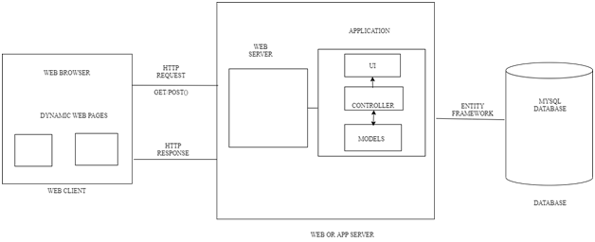
Overall System Structure

Slide 10


Testing
Unit Tests:
Automated
Tested each functionality
Implemented both positive and negative test cases to validate the functionality.
System Tests:
Manual
Checked every functionality according to the requirement.
Implemented both positive and negative test cases to validate the system.

Slide 11
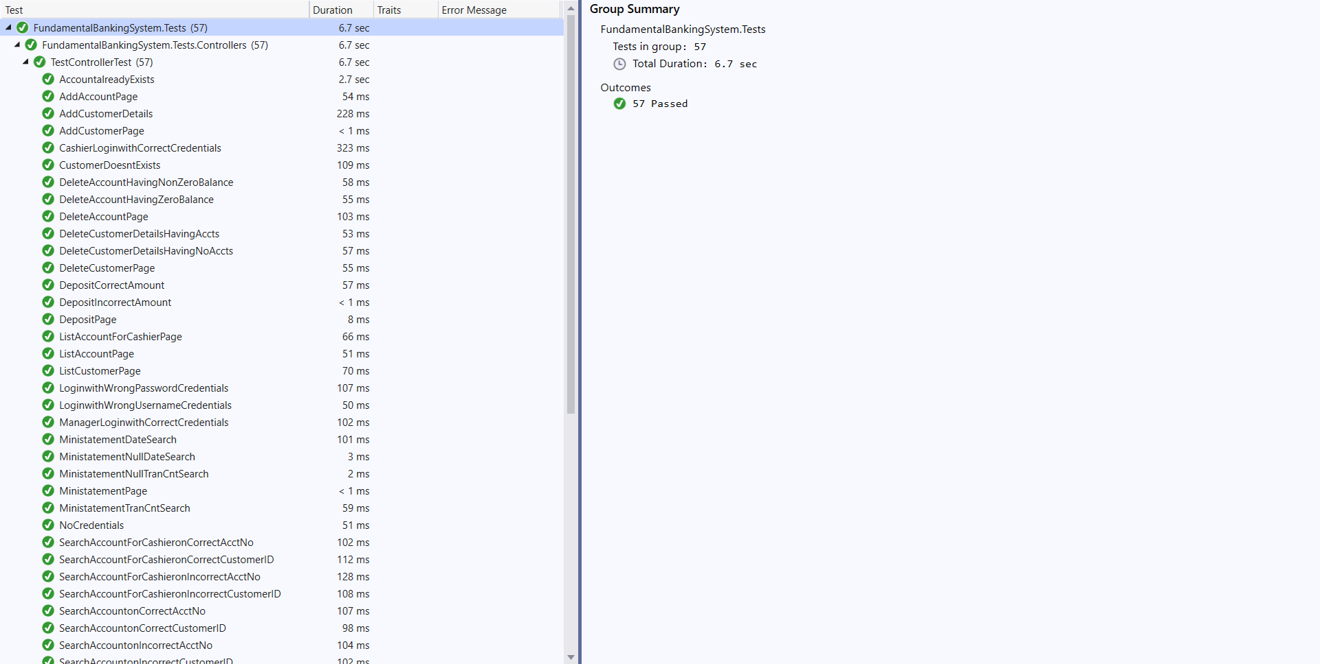
Testing (Contd..)

Slide 12

Feedback from peer reviews and code inspection
Peer review feedback received from team Mystic Gang:
Feedback : Is there any action on the accounts which has no transaction more than two years?
This feedback is rejected as we are not keeping any sort of restriction on the accounts. This can be done in future works.
Feedback : Ministatement Print
This feedback is rejected as we are not integrating any external devices to the application right now. This can be added to our future works.
No suggestions in terms of code.

Slide 13
Limitations
Restricted to Manager and Cashier.
Ministatement print function.
No extra features of a typical banking system such as
Loans
Offers
Repopulating date on update page.

Slide 14


Challenges: Implementing security features.

Slide 15

http://businessbank.gear.host/

Slide 16
Questions..?
Notes:
You can safely remove this slide. This slide design was provided by SlideModel.com – You can download more templates, shapes and elements for PowerPoint from http://slidemodel.com

Slide 17
Thank You
Notes:
You can safely remove this slide. This slide design was provided by SlideModel.com – You can download more templates, shapes and elements for PowerPoint from http://slidemodel.com

